Slide 1
PRIVACY PRESERVING QUERY OVER ENCRYPTED GRAPH-STRUCTURED DATA IN OUTSOURCED ENVIRONMENT DOMAIN: DATA MINING PRESENTED BY E.ROOBINI (211415104221) N.MEENARAJI (211415104146) UNDER THE GUIDANCE OF MRS.K.NIVETHITHA

Slide 2
ABSTRACT:
The expanding enthusiasm for gathering and distributing a lot of people's information to open for purposes, for example, therapeutic research, showcase examination and practical measures has made significant security worries about person's delicate data.
. First as a government they have to allocate ten papers about exam who is going to prepare they need well experience in paper preparation so after preparing all those files should be in encryption for each and every file different key will be generate to different papers after that entire folder they will set one key to access that .
After they can share that file to college so college they can login and see that key if they enter that key correct then they can that key by using of automatic technique here while sharing time any one of the key will be share to student while sending time that key will be merged in one QR code if the student registered in that college they can login and they can scan that QR code then they can get the key if they enter that key correctly then one request should be send to government. Related to that key government will send that file to that college student.
In encrypted mode if they want to decrypt that file they have to enter that key correctly.

Slide 3
LITERATURE SURVEY:
TITLE | AUTHOR | YEAR | ADVANTAGES | DISADVANTAGES
Privacy characterization and Quantification in Data publishing | M.H. Afifi, Kai Zhou and Jian Ren | 2018 | Provides two different privacy leakage metrics | It lacks optimization of chosen set of identifiers to minimize distribution and entropy leakage.
Secure Key for Authentication and secret sharing in Cloud computing | Santhosh Lomte, Shraddha Dudhani | 2017 | MRSE schemes to achieve various stringent privacy requirements | Multi keyword semantics and integrity check of rank order
Security Techniques for data protection in cloud computing | Kire Jakimoski | 2016 | Multi factor authentication scheme | It lacks Security control
Secure Multi-Keyword Top-K Retrieval over encrypted cloud data using Homomorphic Encryption | Sruthi.V, Surekha Mariam Varghese | 2015 | It enables TRSE Scheme. Vector space model and key management are used | It lacks homomorphic encryption which supports reduced cipher text and key size

Slide 4
EXISTING SYSTEM | PROPOSED SYSTEM
EXISTING CONCEPT:- The increasing interest in collecting and publishing large amounts of individuals’ data to public for purposes such as medical research, market analysis and economical measures has created major privacy concerns about individual’s sensitive information. | PROPOSED CONCEPT:- We first present a novel multi-variable privacy characterization and quantification model. We are able to analyze the prior and posterior adversarial belief about attribute values of individuals. We can also analyze the sensitivity of any identifier in privacy characterization. Then we show that privacy should not be measured based on one metric.

Slide 5
EXISTING ALGORITHM:- Incognito Algorithm | PROPOSED ALGORITHM:- Privacy Preserving Data-mining (PPDP)
ALGORITHM DEFINITION:- The Incognito algorithm generates the set of all possible k-anonymous full-domain generalizations of T, with an optional tuple suppression threshold. Each iteration considers a graph of candidate multi- attribute generalizations (nodes) constructed from a subset of the quasi-identifier of size i. | ALGORITHM DEFINITION:- These methods are called as Privacy Preserving Data Mining (PPDM). There are various PPDM directions adopted to avoid disclosure of sensitive information some of them are Privacy Preserving Data Publishing (PPDP), Query Auditing, cryptographic methods and changing Mining Results.
DRAWBACKS:- They lack a proper privacy characterization and measurement. | ADVANTAGES:- Multi-variable privacy characterization and quantification model. It provides a foundation for design and analysis of PPDP schemes.

Slide 6
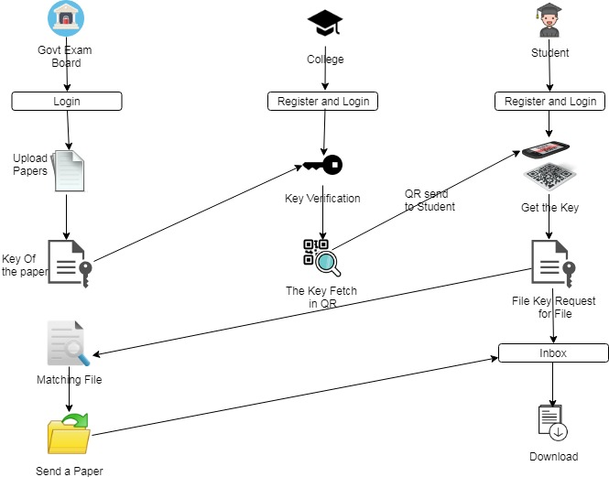
ARCHITECTURE:

Slide 7
FEASIBILTY STUDY
The main objective of the feasibility study is to test the Technical, Operational and Economical feasibility for adding new modules and debugging old running system.
Technical Feasibility
Operational Feasibility
Economical Feasibility
TECHNICAL FEASIBILITY
Technical Feasibility centers on the existing computer system hardware, software, etc. and to some extent how it can support the proposed addition.
Technical Feasibility is mainly concerned with the study of function, performance, and constraints that may affect the ability to achieve the system.
Since the project is designed with Java as Front end and MYSQL as Back end. It is more efficient, easy and user-friendly to understand by almost everyone.
Huge amount of data can be handled efficiently using SQL Server as back end. Hence this project has good technical feasibility.

Slide 8
ECONOMIC FEASIBILITY
Economic Feasibility is mainly concerned with the cost incurred in the implementation of
the software.
Since this project is developed using Java and SQL Server which is more commonly available and even the cost involved in the installation process is not high.
Thus the proposed system is efficient, reliable and also quickly responding.
OPERATIONAL FEASIBILITY
People are inherently instant to change and computers have been known to facilitate change.
The staff is accustomed to computerized systems. These kinds of systems are becoming more common day by day for evaluation of the software engineers.
Hence, this system is operationally feasible.

Slide 9
HARDWARE REQUIREMENTS
PROCESSOR : INTEL CORE i5
RAM : 8GB DDR4 RAM
HARD DISK : 1TB
SOFTWARE REQUIREMENTS
FRONT END : J2EE (JSP, SERVLET)
BACK END : MY SQL
OPERATING SYSTEM : WINDOWS
IDE : ECLIPSE

Slide 10
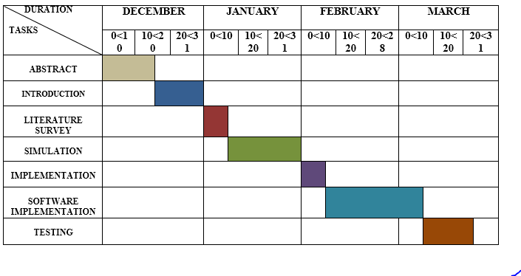
TIMELINE CHART

Slide 11
THANK YOU

